Slide 1
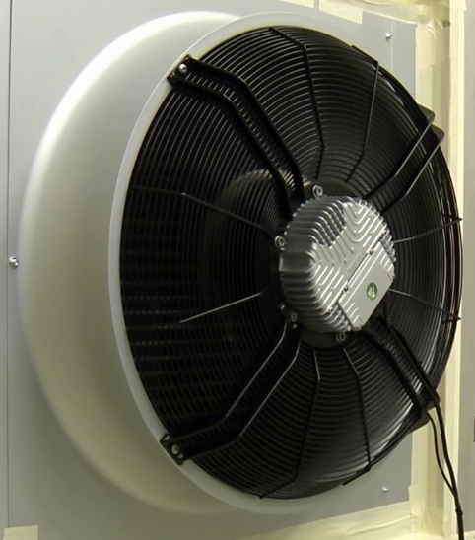
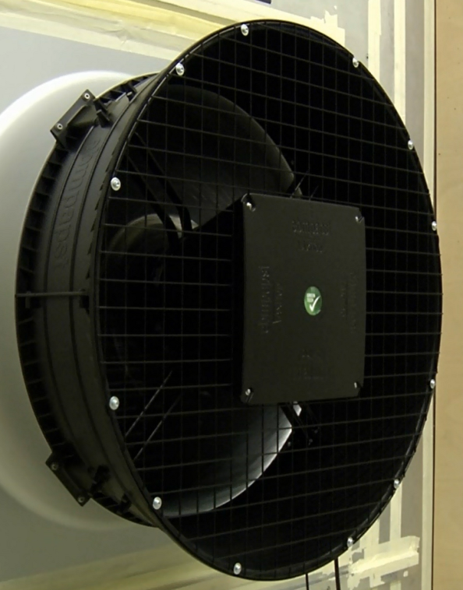
5. Facts and features “Listen to the difference”
click to hear
click to hear
w/o AxiTop
w/

